Slide 1
Managing Hybrid Attraction and Retention During The Great Resignation
Tom Meier
Equis Consulting
You Are
Here

Slide 2
Quote For Today
Managing Hybrid
Pave the path to retention
“We can’t wait for the storm to blow over…
We have to learn how to work in the rain!”
- Jennifer Granholm

Slide 3
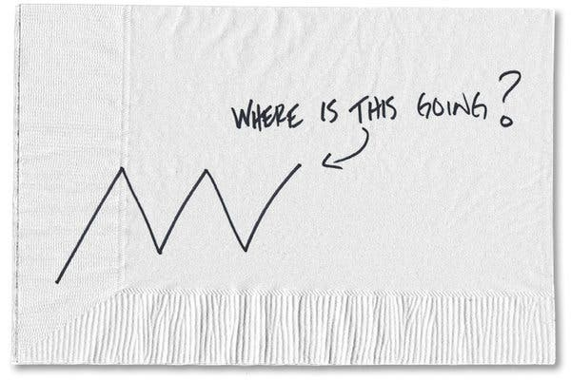
Pandemonium
Managing Hybrid
Pave the path to retention
Delta
Omicron
Gamma

Slide 4
Pandemonium
Managing Hybrid
Pave the path to retention

Slide 5
The Great Resignation
By The Numbers…
33 Million resigned since April 2021*
1/5 of total U.S. Workforce*
40% cited burnout
34% cited organizational change
20% cited lack of flexibility / recognition
28% left without another job lined up
Managing Hybrid
Pave the path to retention

Slide 6
We All Want More
Managing Hybrid
Pave the path to retention
Autonomy
Connection
Meaning

Slide 7
The Gallup 12
Managing Hybrid
Pave the path to retention
I know what is expected of me at work.
I have the materials and equipment I need to do my work right.
At work, I have the opportunity to do what I do best every day.
In the past seven days, I have received recognition or praise.
My supervisor, or someone at work, seems to care about me as a person.
There is someone at work who encourages my development.
At work, my opinions seem to count.
The mission or purpose of my company makes me feel my job is important.
My associates or fellow employees are committed to doing quality work.
I have a best friend at work.
In the past six months, someone at work has talked to me about my progress.
In the past year, I have had opportunities at work to learn and grow.

Slide 8
We All Want More
Managing Hybrid
Pave the path to retention
AUTONOMY
Connection
Meaning

Slide 9
We All Want More…
Managing Hybrid
Pave the path to retention
Relentless “figure it out” problem solving driven by primary stressors and a lack of direction has caused us to demand choice and
AUTONOMY

Slide 10
Autonomy Looks Like
Managing Hybrid
Pave the path to retention
Manage Comfort
Take In Information
Make Decisions

Slide 11
Autonomy
Managing Hybrid
Pave the path to retention
I know what is expected of me at work.
I have the materials and equipment I need to do my work right.
At work, I have the opportunity to do what I do best every day.
In the past seven days, I have received recognition or praise.
My supervisor, or someone at work, seems to care about me as a person.
There is someone at work who encourages my development.
At work, my opinions seem to count.
The mission or purpose of my company makes me feel my job is important.
My associates or fellow employees are committed to doing quality work.
I have a best friend at work.
In the past six months, someone at work has talked to me about my progress.
In the past year, I have had opportunities at work to learn and grow.

Slide 12
We All Want More
Managing Hybrid
Pave the path to retention
Autonomy
CONNECTION
Meaning

Slide 13
We All Want More…
Managing Hybrid
Pave the path to retention
Unending social isolation (2 years) compounded by fear and inconsistent information from experts has caused us to need
CONNECTION

Slide 14
Connection Looks Like
Managing Hybrid
Pave the path to retention
Higher Purpose
Common Enemy

Slide 15
Connection
I know what is expected of me at work.
I have the materials and equipment I need to do my work right.
At work, I have the opportunity to do what I do best every day.
In the past seven days, I have received recognition or praise.
My supervisor, or someone at work, seems to care about me as a person.
There is someone at work who encourages my development.
At work, my opinions seem to count.
The mission or purpose of my company makes me feel my job is important.
My associates or fellow employees are committed to doing quality work.
I have a best friend at work.
In the past six months, someone at work has talked to me about my progress.
In the past year, I have had opportunities at work to learn and grow.
Managing Hybrid
Pave the path to retention

Slide 16
We All Want More
Managing Hybrid
Pave the path to retention
Autonomy
Connection
MEANING

Slide 17
We All Want More…
Managing Hybrid
Pave the path to retention
High pandemic mortality* rates, grief, and living in a state of unyielding emotional loss is causing us to demand
MEANING
*W.H.O. 290,000 to 650,000 people die of flu-related causes every year worldwide. COVID-19 has killed over 5 million people worldwide in just 2 years.

Slide 18
Meaning Looks Like
Managing Hybrid
Pave the path to retention
Strategy
HOW
Vision
WHAT
Purpose
WHY
Purpose

Slide 19
Meaning
Managing Hybrid
Pave the path to retention
What’s Your
Noble “Why”?

Slide 20
Meaning
Managing Hybrid
Pave the path to retention
I know what is expected of me at work.
I have the materials and equipment I need to do my work right.
At work, I have the opportunity to do what I do best every day.
In the past seven days, I have received recognition or praise.
My supervisor, or someone at work, seems to care about me as a person.
There is someone at work who encourages my development.
At work, my opinions seem to count.
The mission or purpose of my company makes me feel my job is important.
My associates or fellow employees are committed to doing quality work.
I have a best friend at work.
In the past six months, someone at work has talked to me about my progress.
In the past year, I have had opportunities at work to learn and grow.

Slide 21
The Great Resignation is an emotional migration.
We are all feeling a powerful need to choose who we connect with and how we make a difference.
Managing Hybrid
Pave the path to retention

Slide 22
Cajun Navy Houston
Managing Hybrid
Pave the path to retention

Slide 23
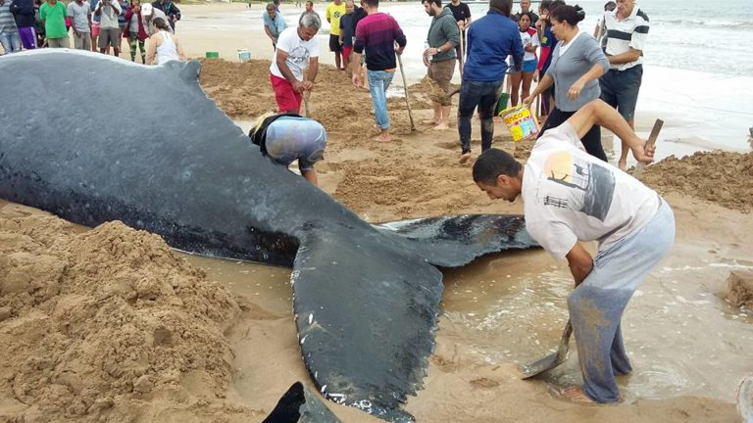
Beached Whale Brazil
Managing Hybrid
Pave the path to retention

Slide 24
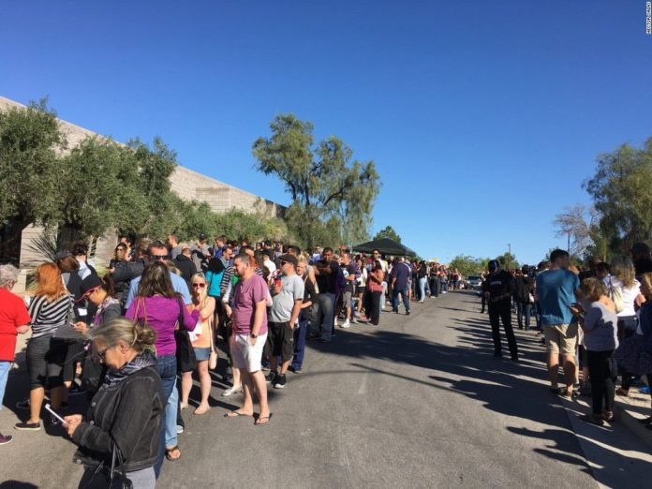
Blood Drive Las Vegas
Managing Hybrid
Pave the path to retention

Slide 25
Beach Cleanup San Juan
Managing Hybrid
Pave the path to retention

Slide 26
Tornado Relief Mayfield
Managing Hybrid
Pave the path to retention

Slide 27
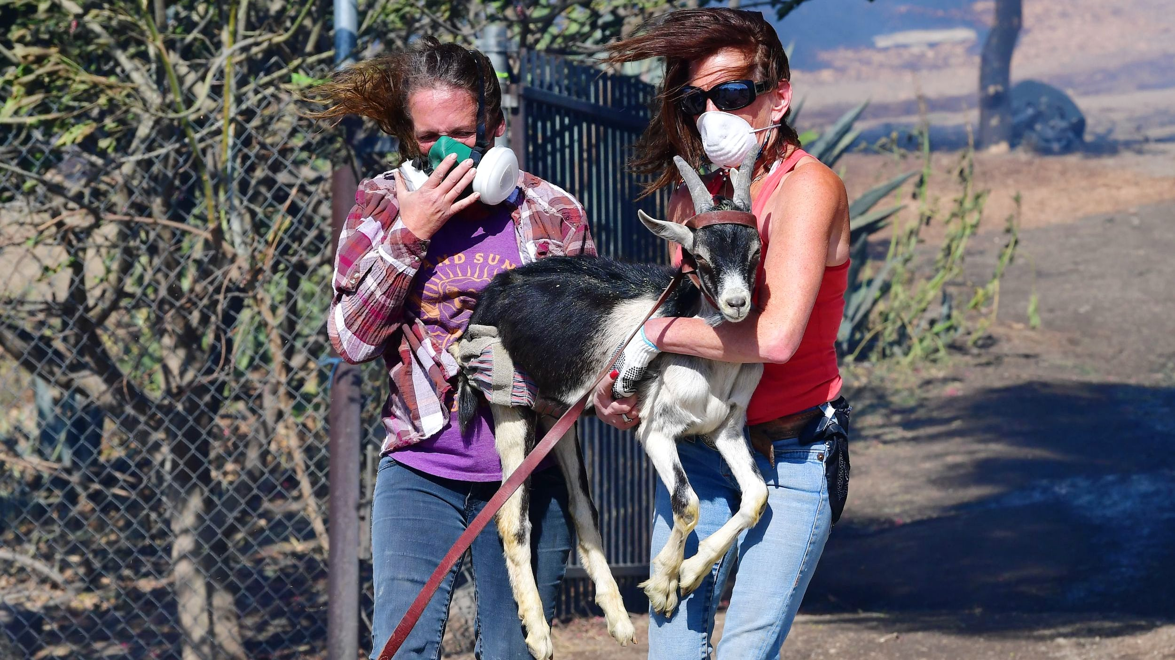
Pet Fire Rescue Denver
Managing Hybrid
Pave the path to retention

Slide 28
Pulse Check
Managing Hybrid
Pave the path to retention
Since Covid, where are you currently working?
Home
Office
Other
Hybrid of locations based on need

Slide 29
Half Full
Managing Hybrid
Pave the path to retention
Quick shift to W@H that maintained functionality.
Lower expenses and no commute.
Broader talent pool.
More flexibility.
Fewer sick days and absenteeism.
Increased independent decision making.
Leveled career management playing field for remote workers.
Increased productivity?

Slide 30
Half Empty
Managing Hybrid
Pave the path to retention
Lack of connection and increased isolation.
Lack of communication.
Challenges to work-life balance.
More distractions.
Lower reliability and accountability.
Increased security challenges.
Lack of structure and resources.
Lack of technology and support.
More meetings / Zoom fatigue.
Long term cultural implications

Slide 31
The Stigma
Managing Hybrid
Pave the path to retention

Slide 32
The Stigma
Managing Hybrid
Pave the path to retention
Confronting W@H Stigma
Acknowledge the stigma and challenge the assumptions
Focus on Outcome much more than process
Celebrate and promote your “rock star” remote contributors

Slide 33
The Bias
Managing Hybrid
Pave the path to retention

Slide 34
The Bias
Managing Hybrid
Pave the path to retention
Confronting “Proximity” Bias
Increase connection regularity
Prioritize remote team member meeting participation
Create networking partnerships between remote and non-remote team members

Slide 35
W@H Personality Types
Managing Hybrid
Pave the path to retention
Work/Life
Blurrance

Slide 36
W@H Personality Types
Managing Hybrid
Pave the path to retention
Segmentors
Integrators
Notes:
Author Christena Nippert-Eng
Home and Work: Negotiating Boundaries

Slide 37
W@H Personality Types
Managing Hybrid
Pave the path to retention
Work
Life
Work
Life
SEGMENTORS
Draw clear lines
Shift Plan-fully
40-hour satisfaction
Strength is Focus
Dedicated work-space
Reluctant to let work interfere with family and vice-versa
INTEGRATORS
Struggle to separate
Shift Flexibly
40-hour challenge
Strength is Multi-tasking
Anywhere work-space
Reluctant to isolate work from family and vice-versa

Slide 38
W@H Personality Types
Managing Hybrid
Pave the path to retention
Which W@H type is more likely to experience greater satisfaction with their work?
Segmentors
Integrators

Slide 39
W@H Personality Types
Managing Hybrid
Pave the path to retention
Which W@H type is more likely to experience greater risk of burnout?
Segmentors
Integrators

Slide 40
W@H Personality Types
Managing Hybrid
Pave the path to retention
Can I Be a Little of Both???
YES!!!
Identify preference with the tools
Adapt your approach
Help the struggling “stragglers”

Slide 41
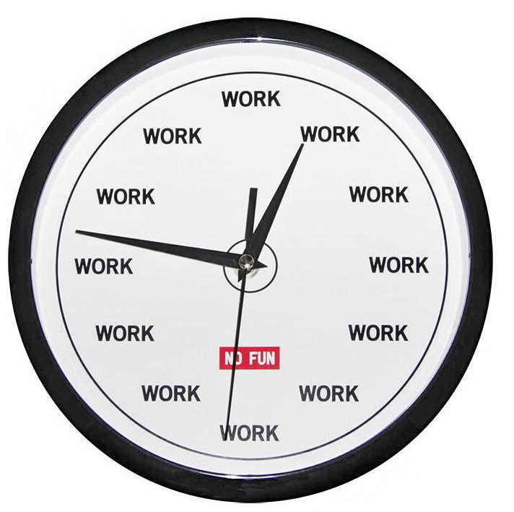
W@H Challenges
Managing Hybrid
Pave the path to retention
SPACE
TIME

Slide 42
W@H Best Practices
Managing Hybrid
Pave the path to retention
SEGMENTORS
INTEGRATORS
Create and maintain a dedicated
PLACE
for your work
Create and maintain a dedicated
ROUTINE
for your work
SPACE
Set and adhere to a
consistent
SCHEDULE
for your work
Set and adhere to
consistent
LIMITS
for your work
TIME

Slide 43
W@H Best Practices
Managing Hybrid
Pave the path to retention
SEGMENTORS
INTEGRATORS
Create a PLACE
Carve out a room or a corner that you consistently use (avoid high traffic areas)
Use a background on video calls
Outfit your space (chair, ear buds, phone stand, power strip, monitor)
Organize a mini file cabinet for frequently referenced documents
Don’t eat at your desk
Create and maintain a dedicated
LOCATION
for your work
Create and maintain a dedicated
ROUTINE
for your work
SPACE
Set and adhere to a
consistent
SCHEDULE
for your work
Set and adhere to
consistent
LIMITS
for your work
TIME

Slide 44
W@H Best Practices
Managing Hybrid
Pave the path to retention
SEGMENTORS
INTEGRATORS
Create and maintain a dedicated
LOCATION
for your work
Create and maintain a dedicated
ROUTINE
for your work
SPACE
Set a SCHEDULE
Establish an official start and stop time for your workday
Block time for proper lunch and breaks
Schedule all commitments
Give yourself permission to handle family issues during work (but schedule it)
Focus and avoid the temptation to “multi-task”
Set and adhere to a
consistent
SCHEDULE
for your work
Set and adhere to
consistent
LIMITS
for your work
TIME

Slide 45
W@H Best Practices
Managing Hybrid
Pave the path to retention
SEGMENTORS
INTEGRATORS
Create a ROUTINE
Dress for work
Set ground rules (if you are sharing space)
Establish a morning, a workflow, and a next-day routine
Post (and maintain) your schedule somewhere visible
Manage Interruptions (sign on the door)
Manage meetings and on-screen video time
Create and maintain a dedicated
LOCATION
for your work
Create and maintain a dedicated
ROUTINE
for your work
SPACE
Set and adhere to a
consistent
SCHEDULE
for your work
Set and adhere to
consistent
LIMITS
for your work
TIME

Slide 46
W@H Best Practices
Managing Hybrid
Pave the path to retention
SEGMENTORS
INTEGRATORS
Create and maintain a dedicated
LOCATION
for your work
Create and maintain a dedicated
ROUTINE
for your work
SPACE
Set LIMITS
Schedule your work around your energy
Block and respect family and down time with shared calendar “unavailable” and phone “do not disturb” features
Develop the discipline to avoid distractions (laundry)
Make commitments outside the house (walk with a friend)
Restrict phone usage in the bedroom
Set and adhere to a
consistent
SCHEDULE
for your work
Set and adhere to
consistent
LIMITS
for your work
TIME

Slide 47
W@H Best Practices
Managing Hybrid
Pave the path to retention
SEGMENTORS
INTEGRATORS
Create and maintain a dedicated
PLACE
for your work
Create and maintain a dedicated
ROUTINE
for your work
SPACE
Set and adhere to a
consistent
SCHEDULE
for your work
Set and adhere to
consistent
LIMITS
for your work
TIME

Slide 48
Long-Haul Skills
Managing Hybrid
Pave the path to retention
Tighten security
Temper expectations
Practice creative flexibility
Over communicate
Clarify everything
Extend “Gracious Space”
Take care of yourself
Notes:
Over Communicate – because everybody is stresses
Clarify Everything – because we are all changing the tires on a moving car

Slide 49
Remember:
Managing Hybrid
Pave the path to retention
We’re all learning how to work in the rain!

Slide 50
Thank You For Attending!
Managing Hybrid
Pave the path to retention

Slide 51
Managing Hybrid Attraction and Retention During The Great Resignation
Tom Meier
Equis Consulting
You Are
Here

